Slide 1


Slide 2

Implementation Details

Slide 3
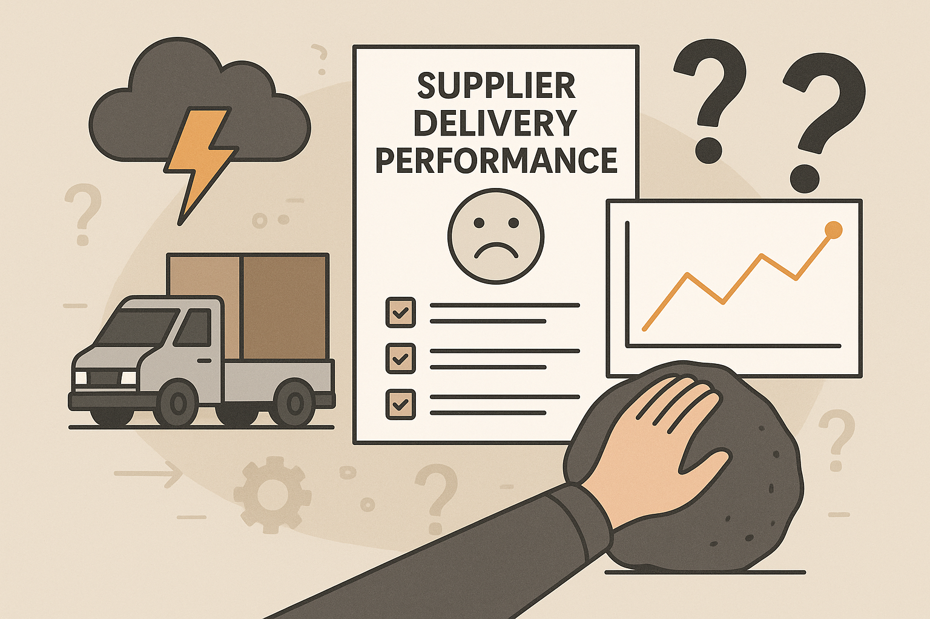
Challenges

Slide 4
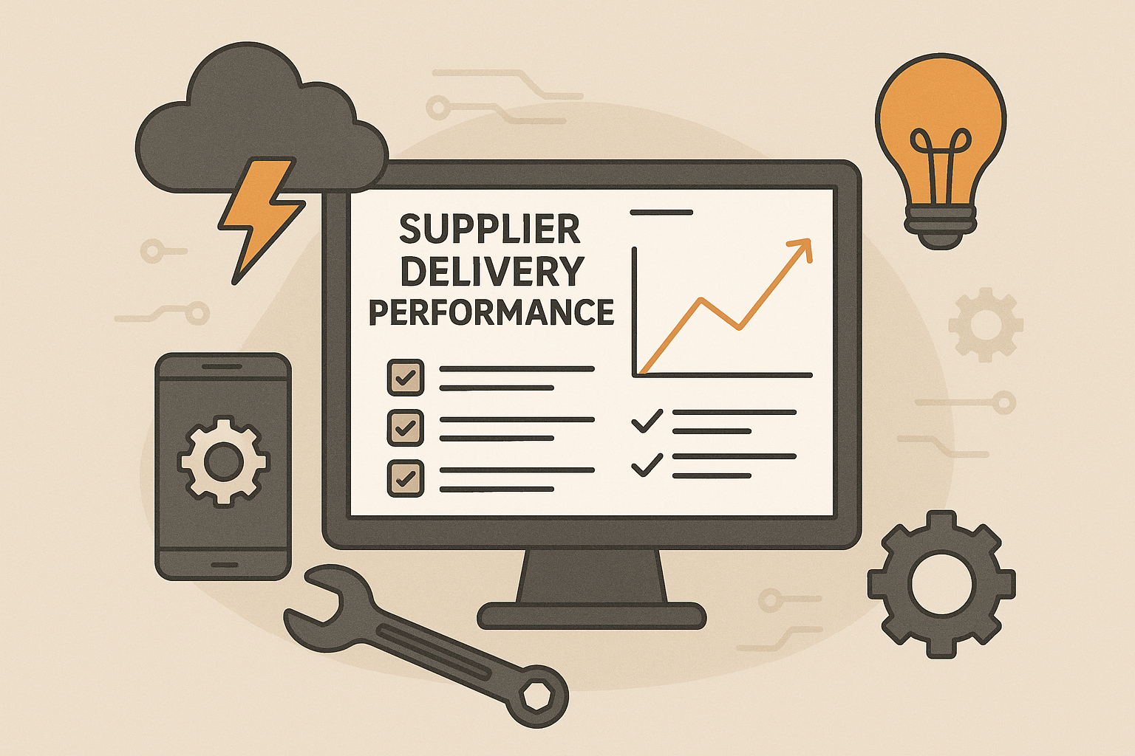
Tools and Technologies

Slide 5
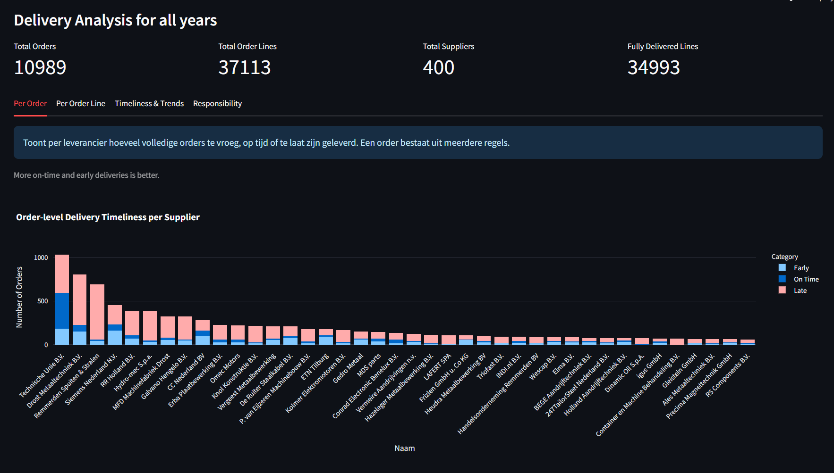
Application Demo

